Slide 1

DA 204o: Data Science in Practice Course Project Proposal Personalized Music Recommendation System
Gayatri Yendamury, MTech (AI) , gayatriy@iisc.ac.in
Bagi Shirisha, MTech (AI), bagishirisha@iisc.ac.in
Priyabrata Samantaray, MTech (ECE), priyabratas@iisc.ac.in
Vineet Kumar Tripathi, MTech (ECE), vineetkt@iisc.ac.in

Slide 2

Problem Definition
Music streaming platforms offer millions of tracks, but users often struggle to find songs that match their choice. Existing recommendation systems are limited, often suggesting irrelevant content, leading to user disappointment and disengagement.
A smarter, data-driven recommendation system is needed to :
enhance personalization,
improve user experience by offering more accurate music suggestions based,
keep users engaged with the platform,
increase user retention and revenue for the platform

Slide 3

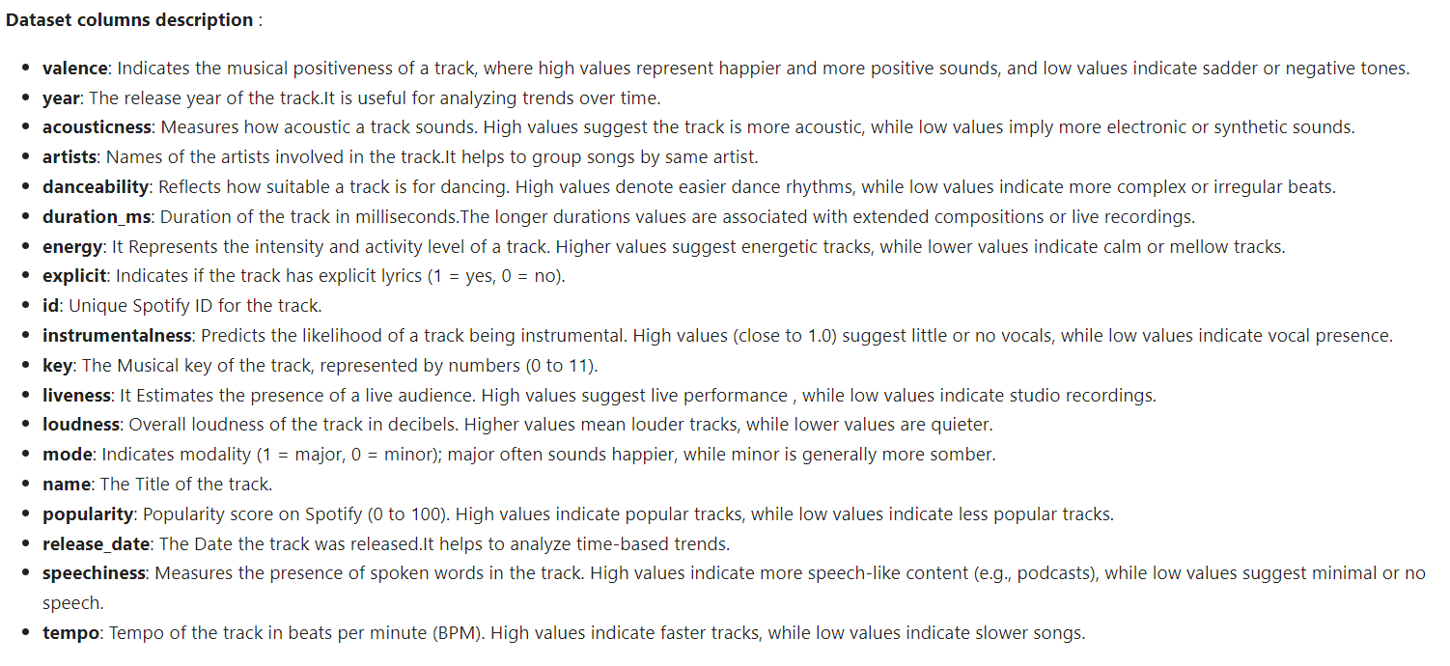
Data Collections and Preparation
Reference: 01_data_collection.ipynb
Data source : Spotify dataset (kaggle.com) : data.csv , data_by_genre.csv
Data.csv : (170,653 , 19)
Data_by_genre: (2973, 14)
Features (Columns): The dataset contains 19 features, including:
Numerical: valence, year, acousticness, danceability, duration_ms, energy, explicit, instrumentalness, key, liveness, loudness, mode, popularity, speechiness, tempo
Categorical: artists, id, name, release_date, genre
Size: 170,653 records (rows).
Format: CSV file with mixed data types (numerical, categorical, and text).

Slide 4
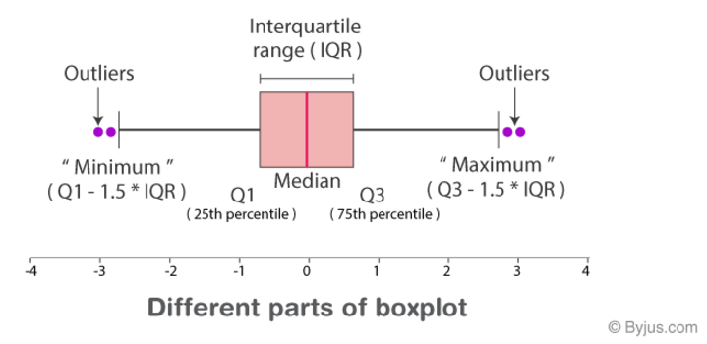
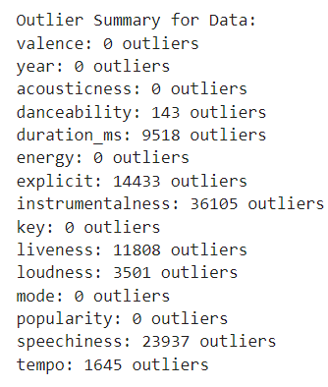
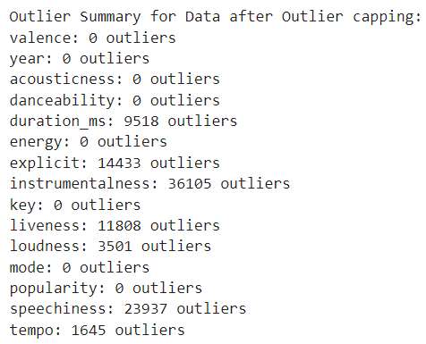
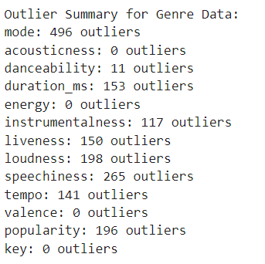
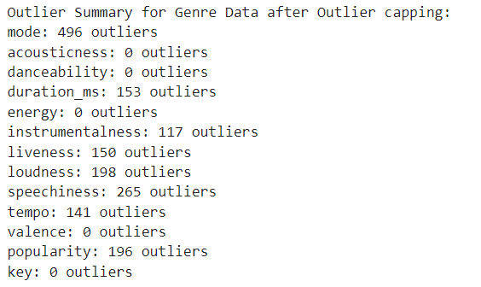

Data Collections and Preparation
Reference: 02_data_preprocessing.ipynb
Data preprocessing steps
Check Data completeness: No missing values and duplicate rows found .
Descriptive statistics: Descriptive statistics performed.
Check Outliers: Outliers visualized via Boxplots and outliers counted using interquartile range
Outlier Handling: Outlier capping performed only on danceability as the other features had too many outliers and can provide useful information for recommendation system.
Feature engineering: New music feature categorical columns added , ‘duration min’ , ‘release decade’ added . Column ‘release date’ is inconsistent and thus discarded. New columns 'artist_count’, 'artist_category' are added based on artist.

Slide 5
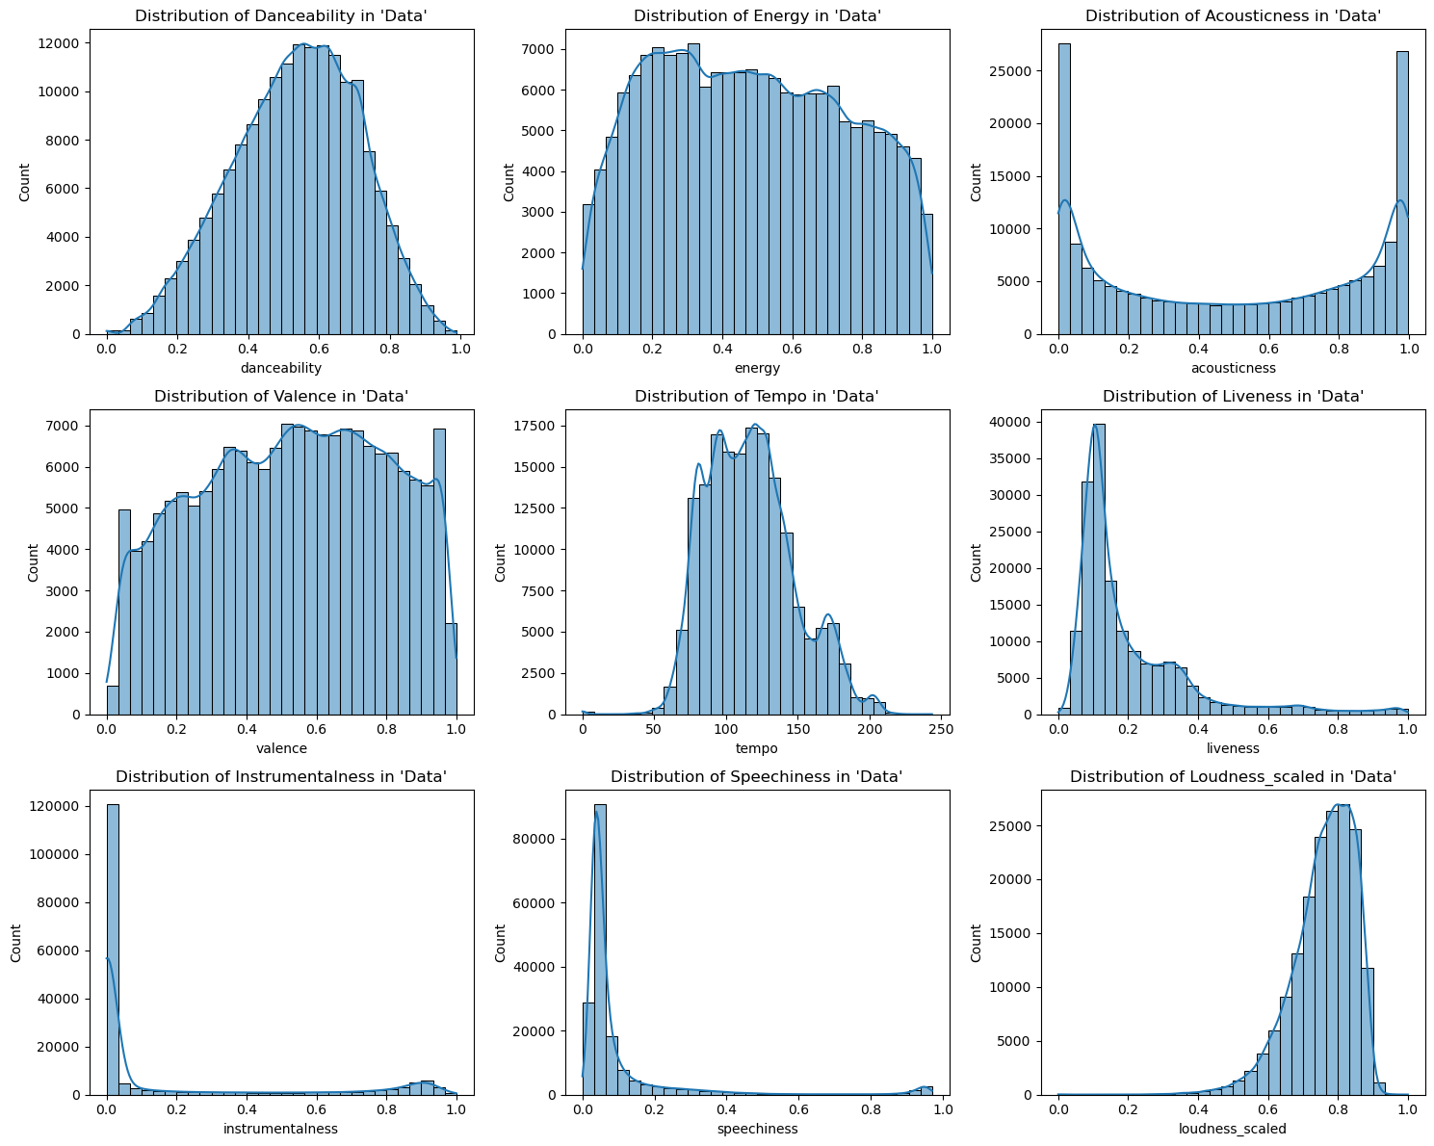
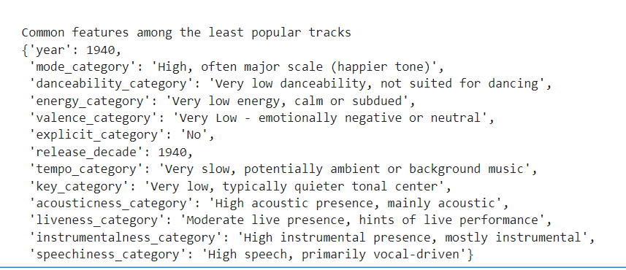
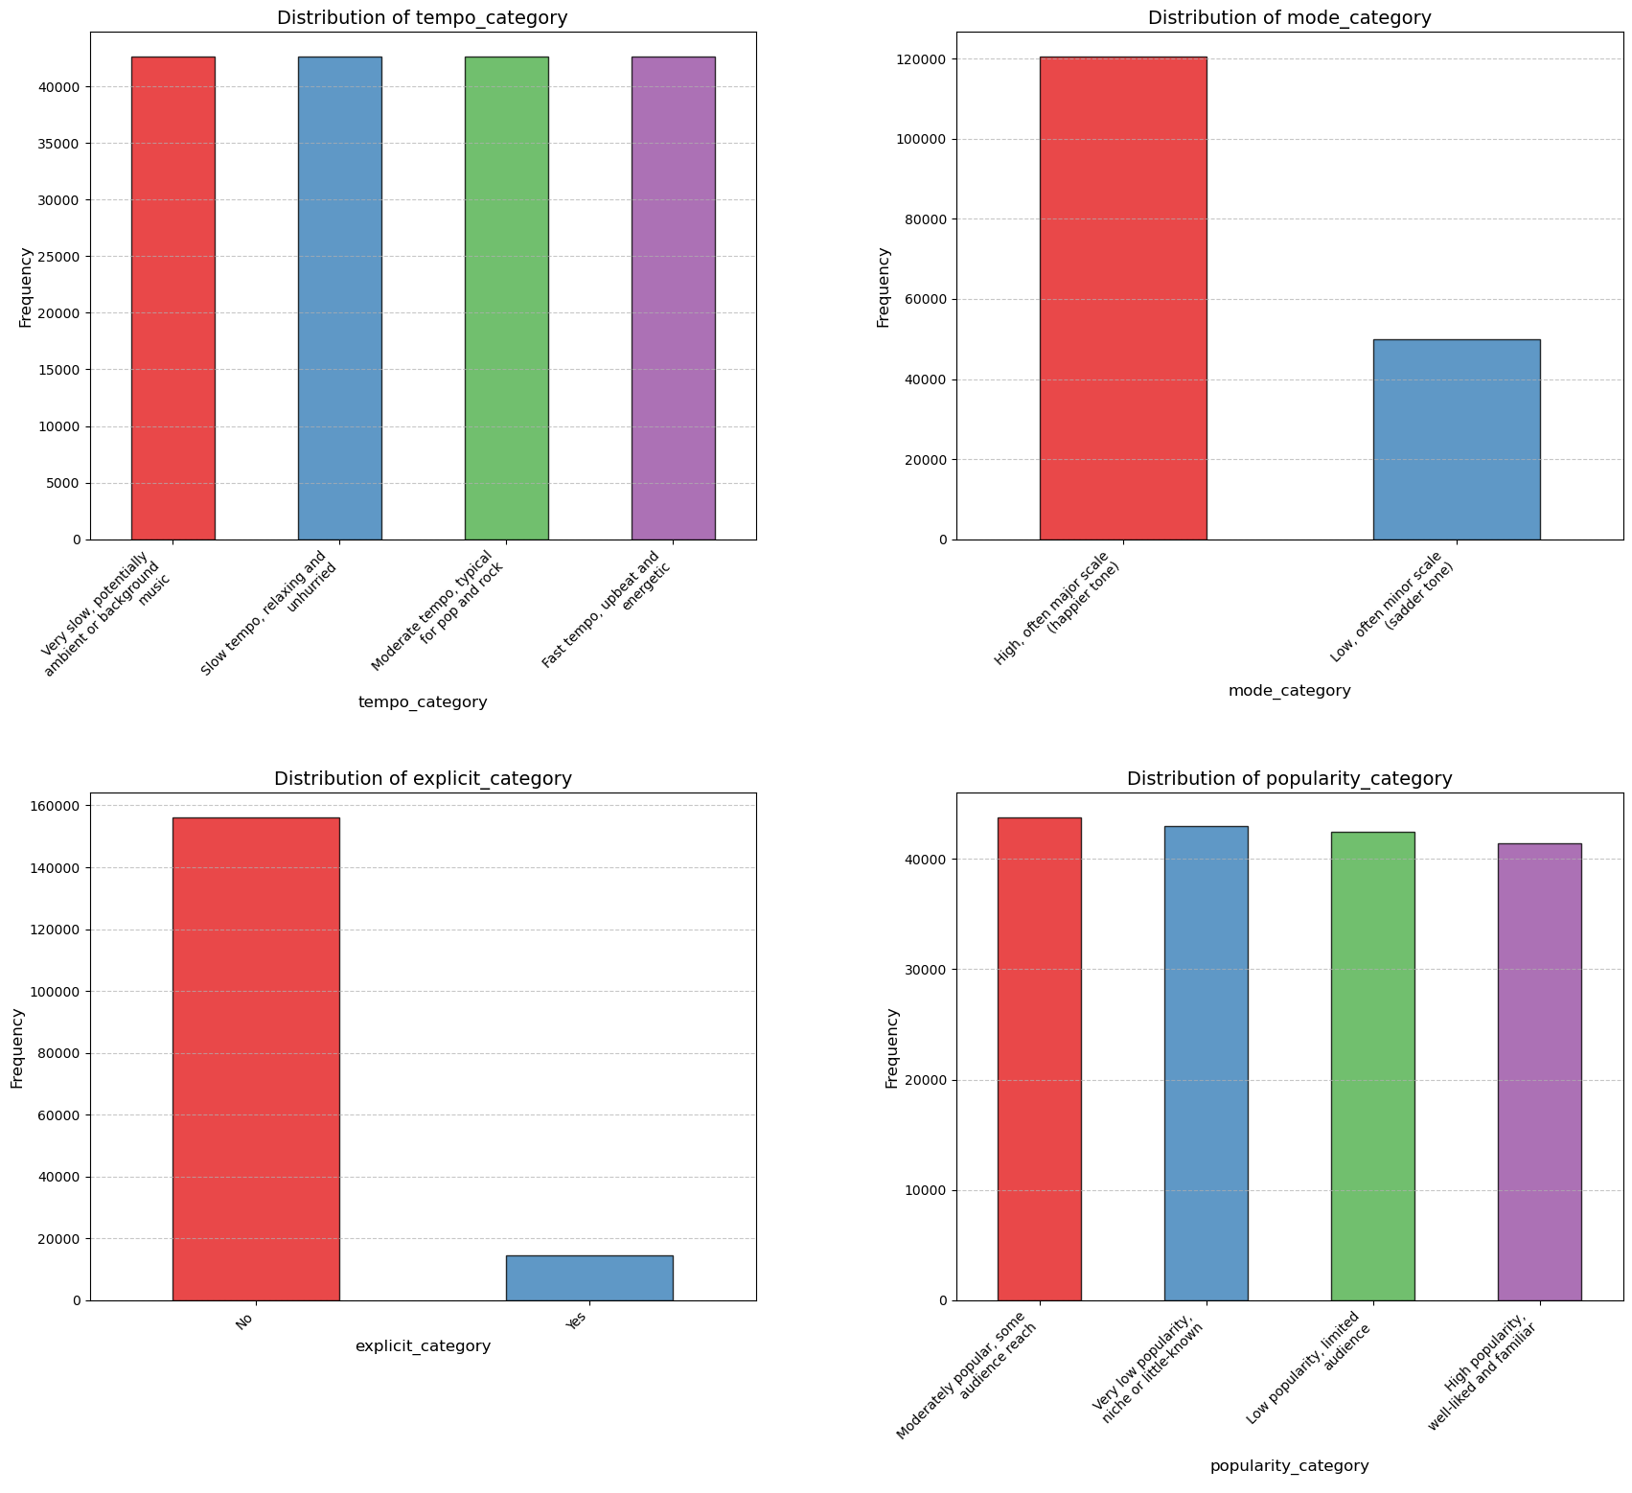
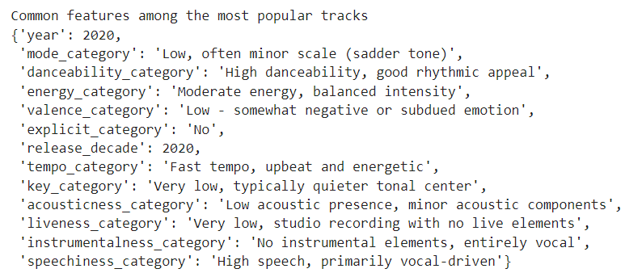
Data Exploration
Reference: 03_data_Exploration.ipynb
Common Features among the least popular tracks
Distribution of categorical features
Common Features among the most popular tracks
Distribution of
numerical features
DA 204o: Data Science in Practice
5

Slide 6
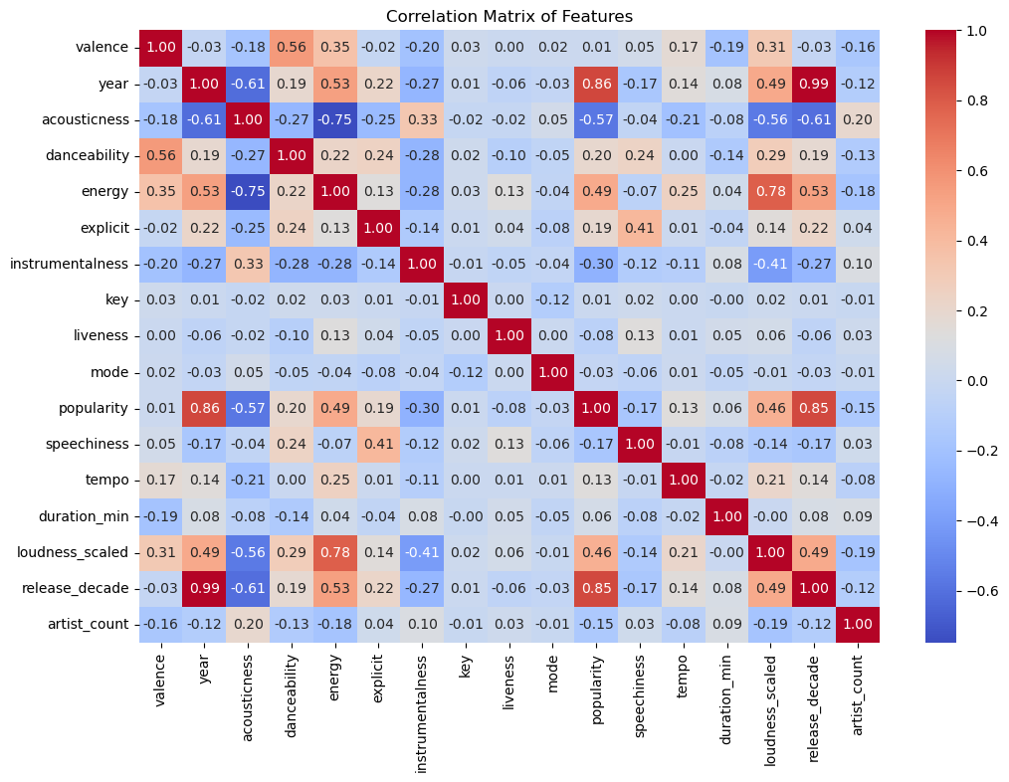
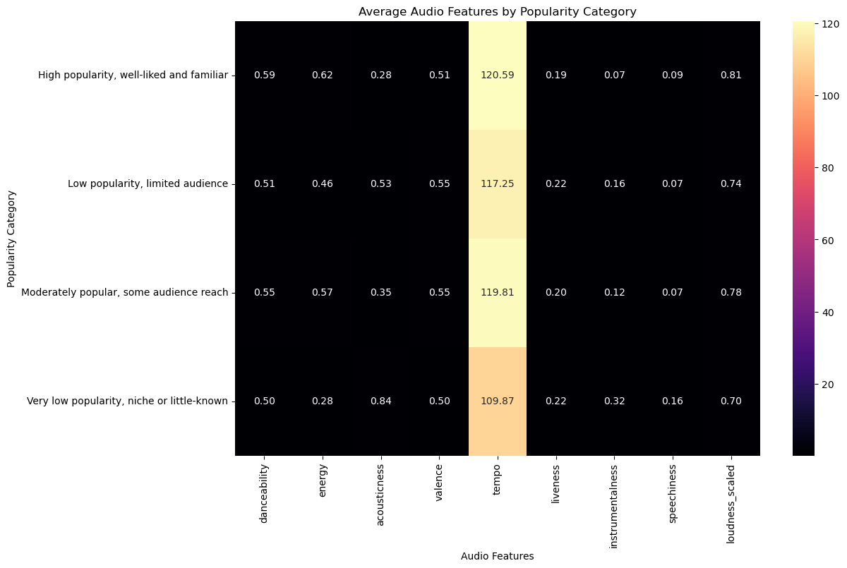
Data Exploration
Reference: 03_data_Exploration.ipynb
Bivariate Analysis - Numerical vs. Numerical Relationships:
Correlation Analysis : Heatmap is observed for Numerical Feature Correlations as shown below. Strong correlations were found between Year and Popularity, Energy and Loudness.

Slide 7
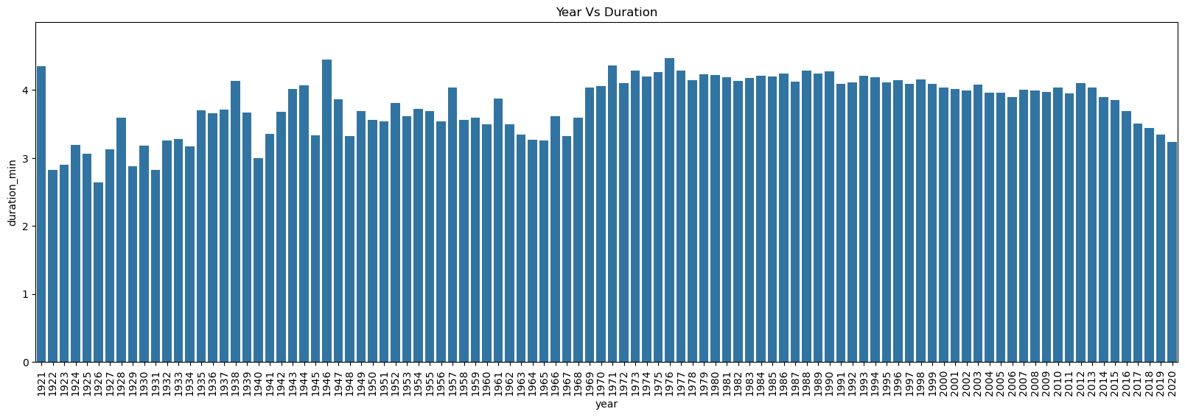
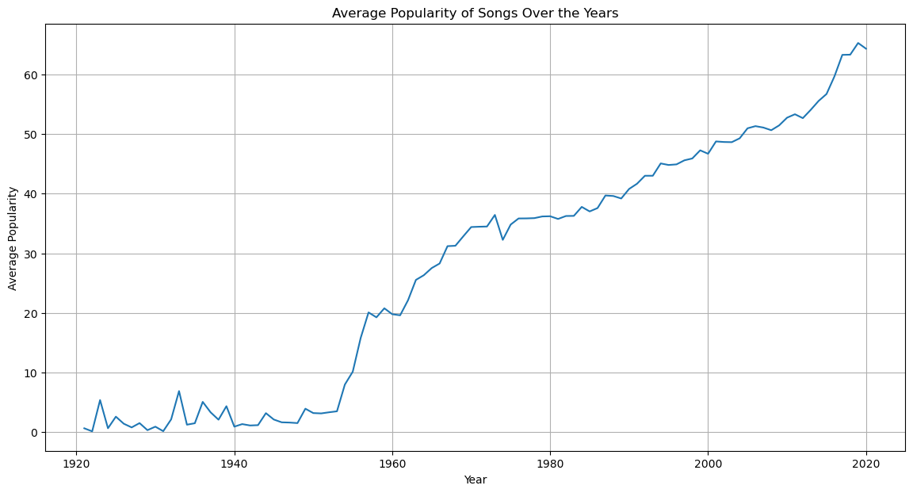
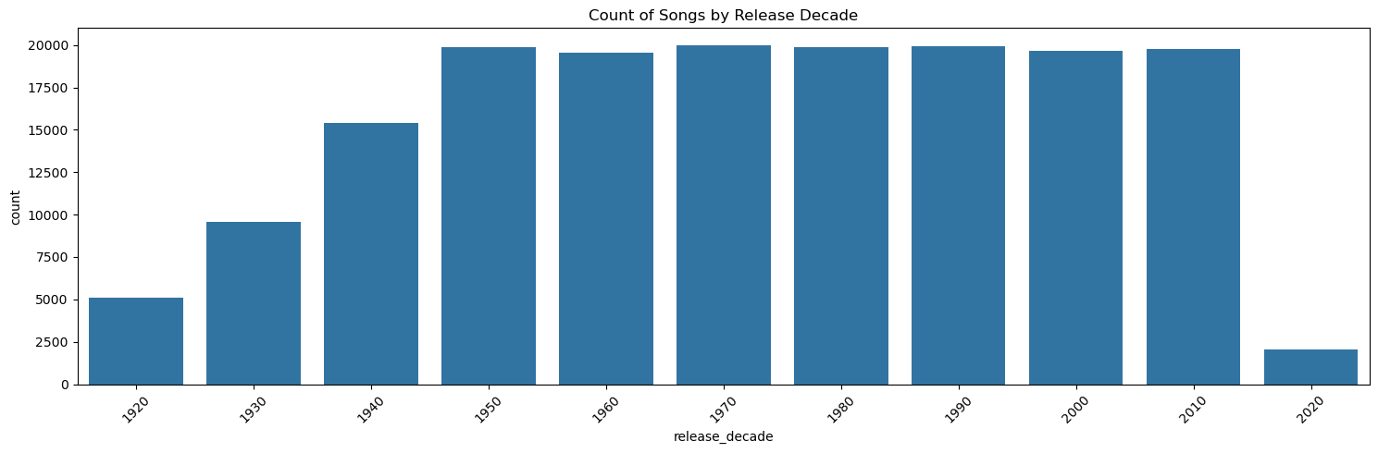
Data Exploration
Reference: 03_data_Exploration.ipynb
Trend analysis: Over the years , the trend of song duration , average popularity of songs , count of songs produced was observed.
DA 204o: Data Science in Practice
7

Slide 8
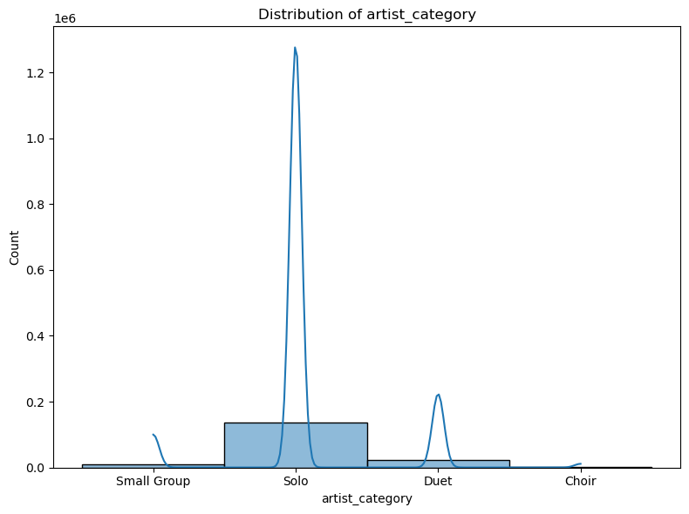
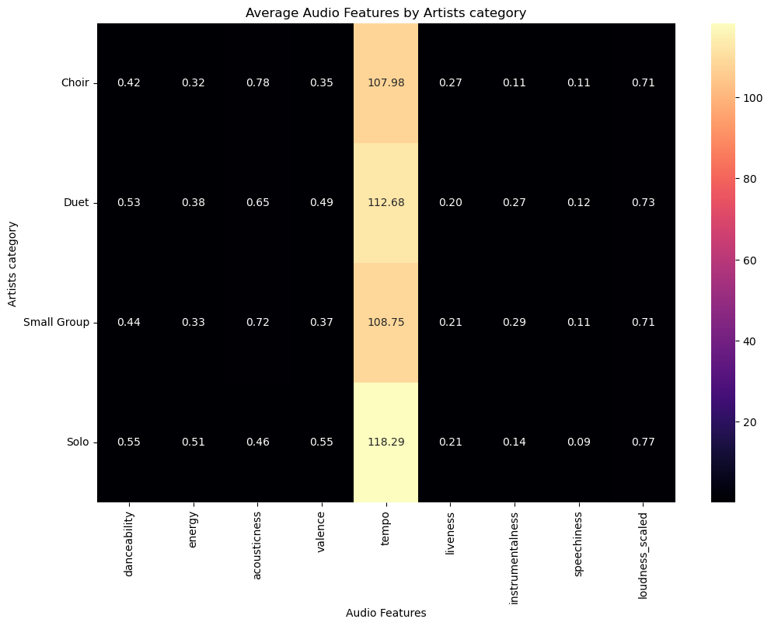
Data Exploration
Reference: 03_data_Exploration.ipynb
Analysis based on artists :
Distribution of artist category: Distribution of the artist type like solo, duet, small group and choir is observed.
Average audio features by artist category: Based on the artist type , the average of music features is observed.

Slide 9
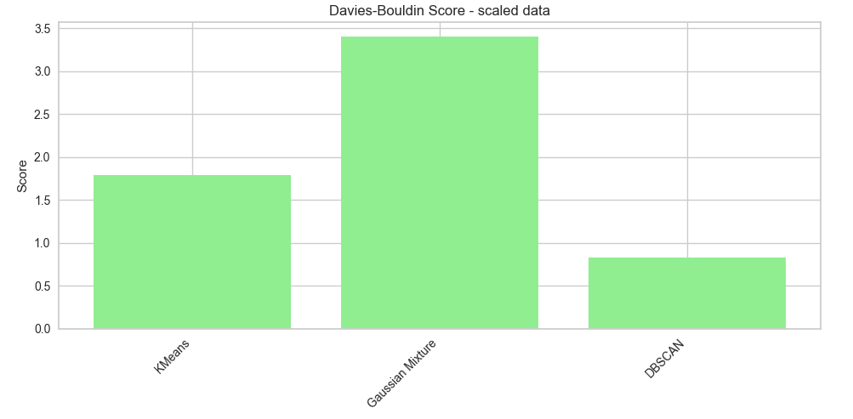
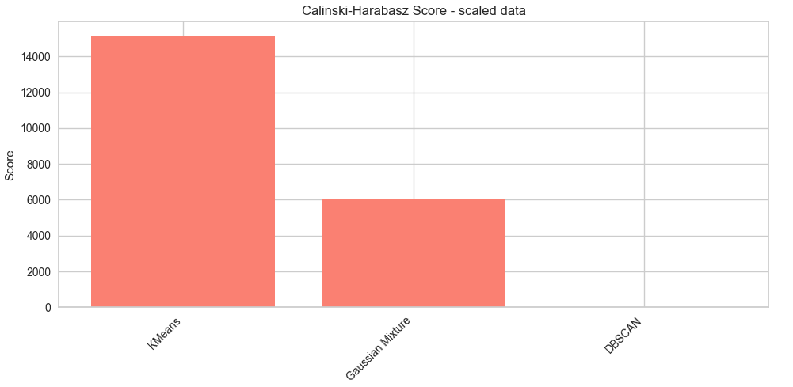
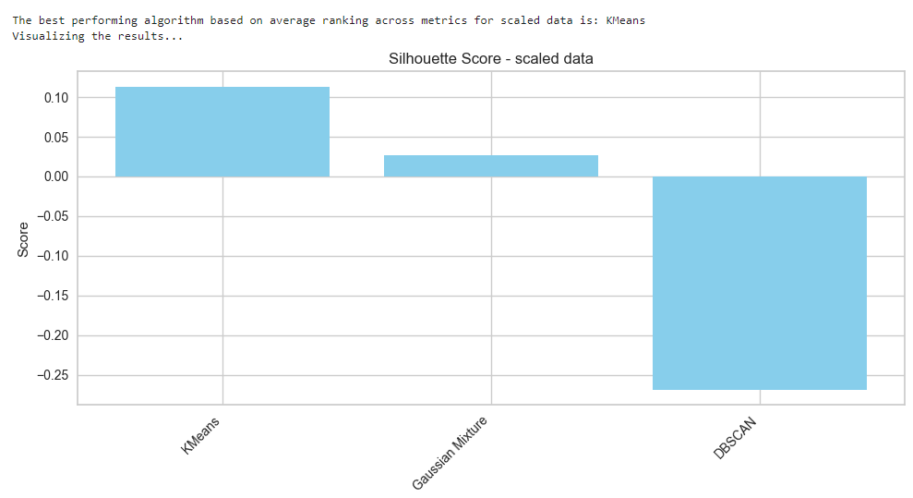
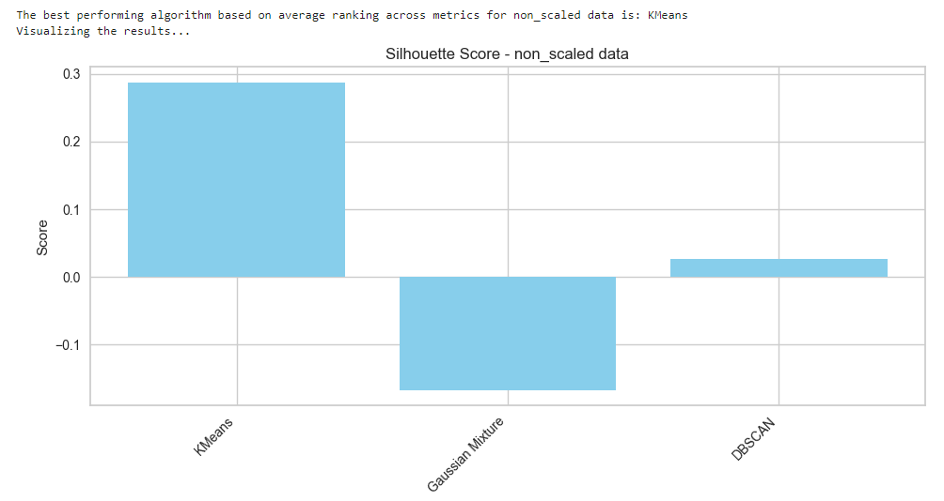
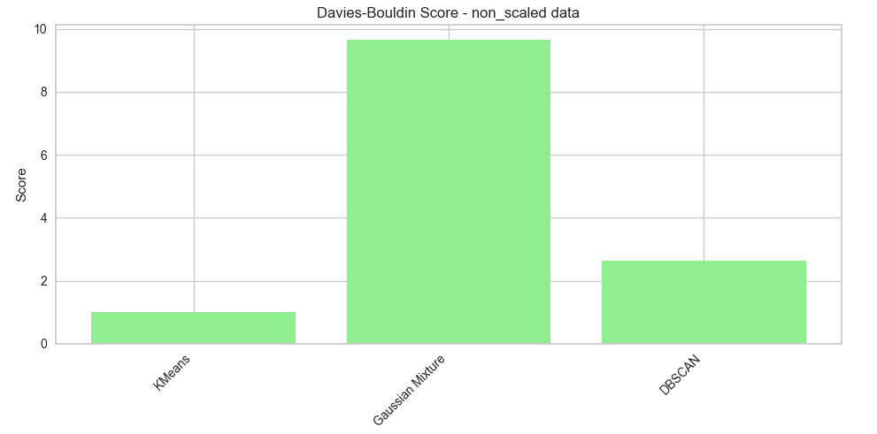
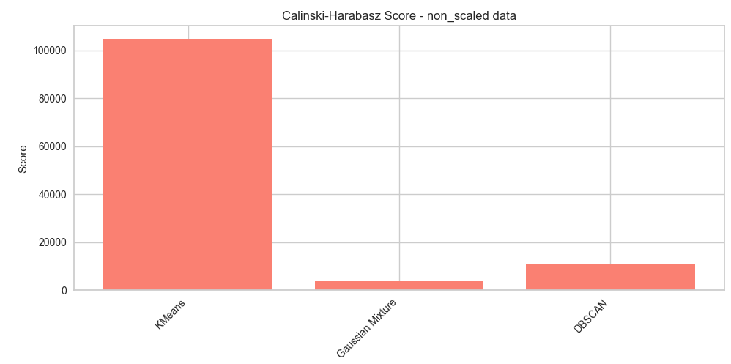
Reference: 04_Model_Selection.ipynb
Model Selection
Best Algorithm: K-Means
Data.csv
Scaled
Non
Scaled
Silhouette Score
Calinski-Harabasz Score
Measures the similarity of an object to its own cluster compared to other clusters.
Davies-Bouldin Score
Measures the average similarity between clusters, where similarity is the ratio of the sum of intra-cluster distances to inter-cluster distances.
It measures the ratio of the sum of between-cluster dispersion to within-cluster dispersion.
Higher Score: Indicates a good match to its own cluster and poor match to neighboring clusters, suggesting well-defined, separate clusters.
Higher Score: Indicates clusters are well-separated and dense, which reflects a better clustering structure.
Lower Score: Indicates the clusters are not distinctly separated and might be too spread out.
Higher Score: Indicates poor clustering, as clusters are either overlapping or dispersed.
Lower Score: Indicates overlapping clusters.
Lower Score: Indicates better clustering, as clusters are more compact and better separated.
DA 204o: Data Science in Practice
9

Slide 10
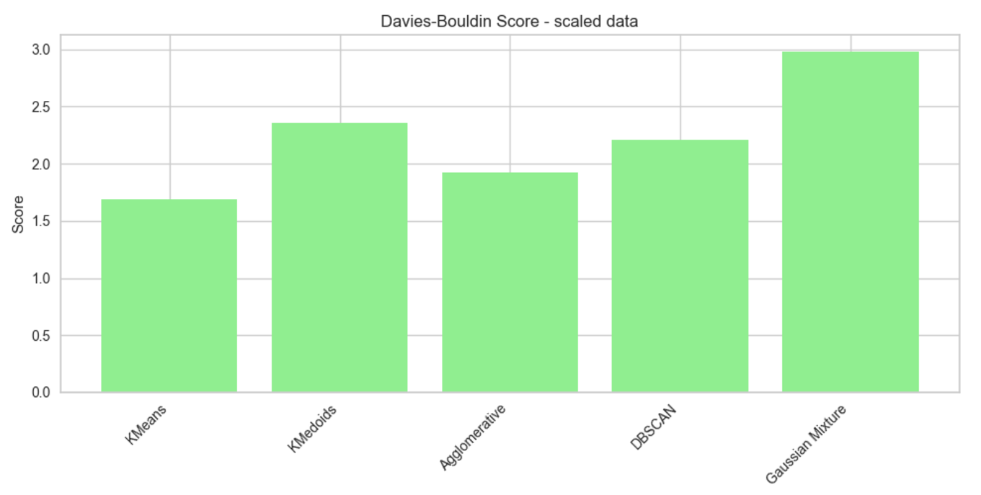
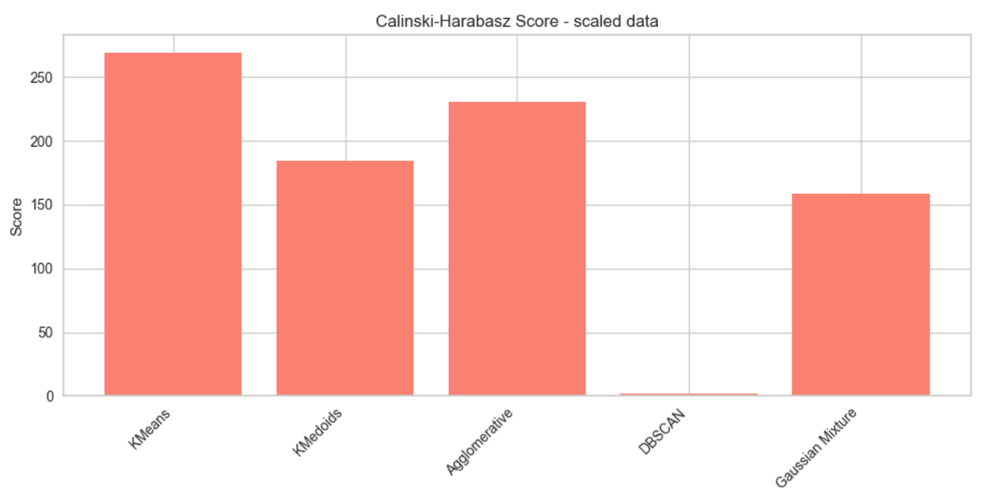
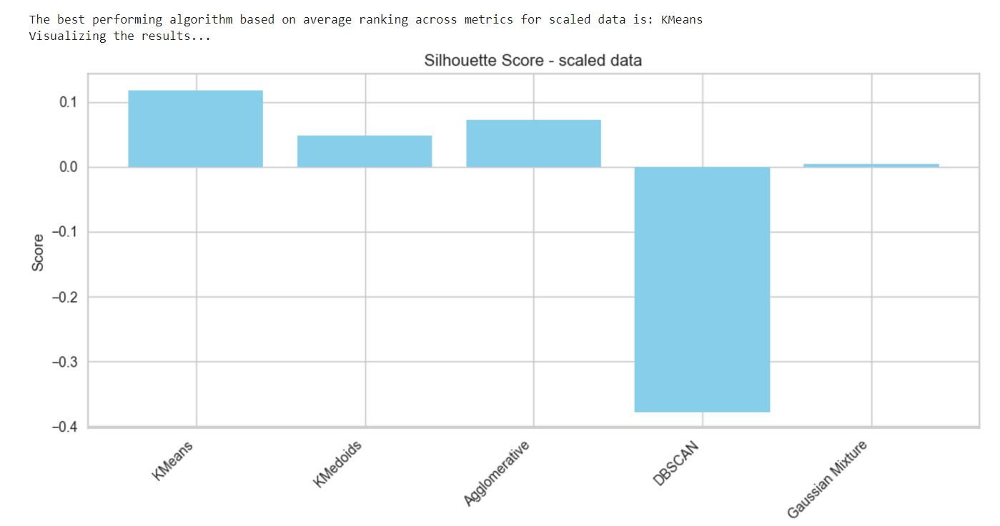
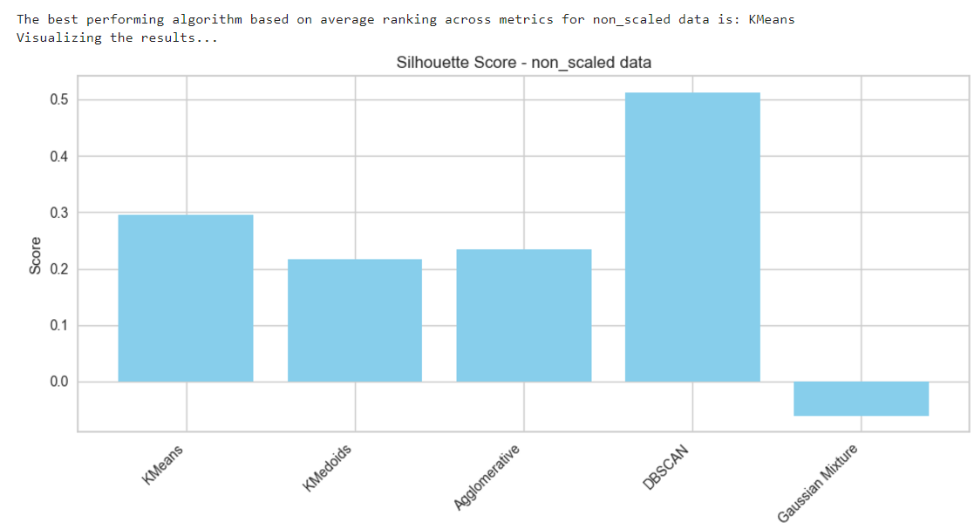
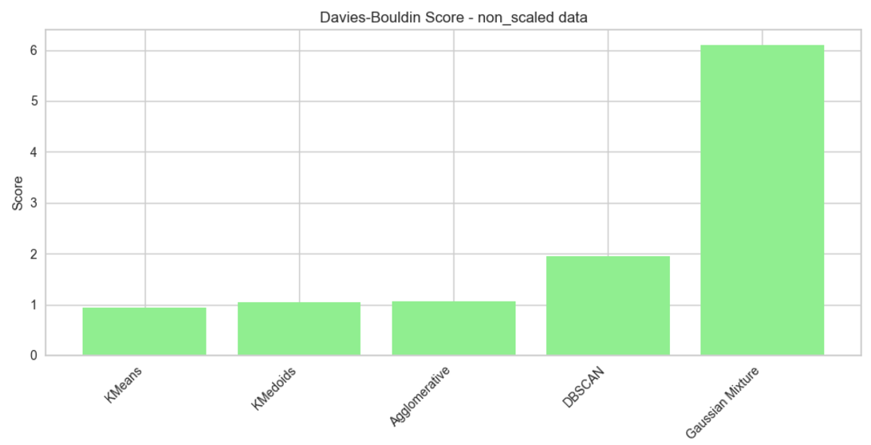
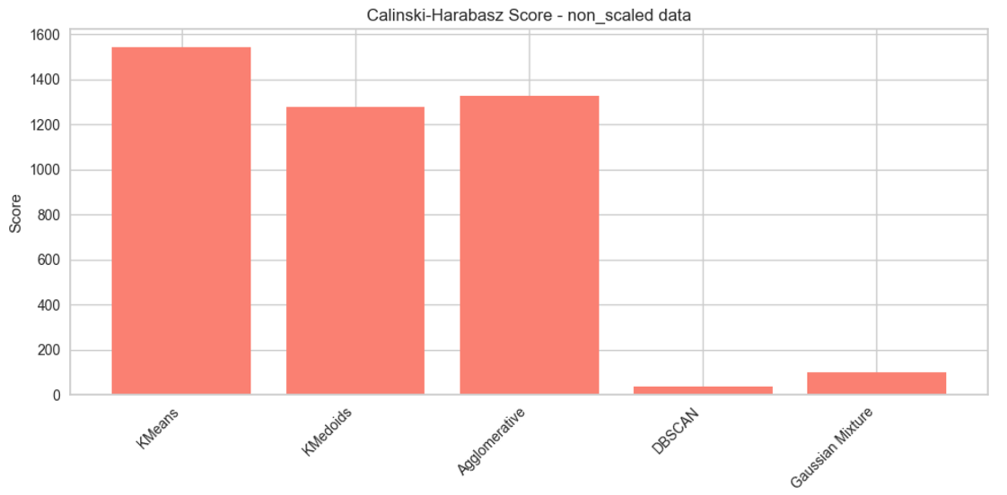
Reference: 04_Model_Selection.ipynb
Model Selection
Best Algorithm: K-Means
Genre_data.csv
Scaled
Non
Scaled
Based on the data from the chart's, clustering performance is generally better with non-scaled data for this dataset.
The non-scaled data shows higher silhouette and Calinski-Harabasz scores and lower Davies-Bouldin scores, which collectively suggest more effective and distinct clustering compared to when the data is scaled.
This implies that scaling, in this case, might distort important relationships and distributions in the data that are crucial for effective clustering.

Slide 11
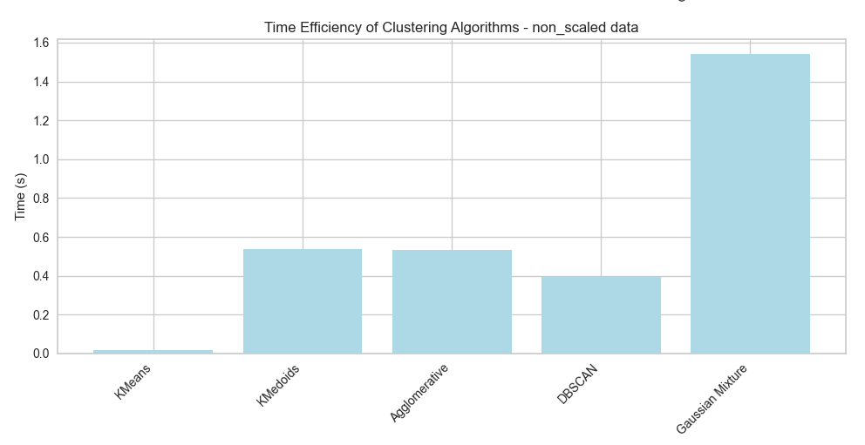
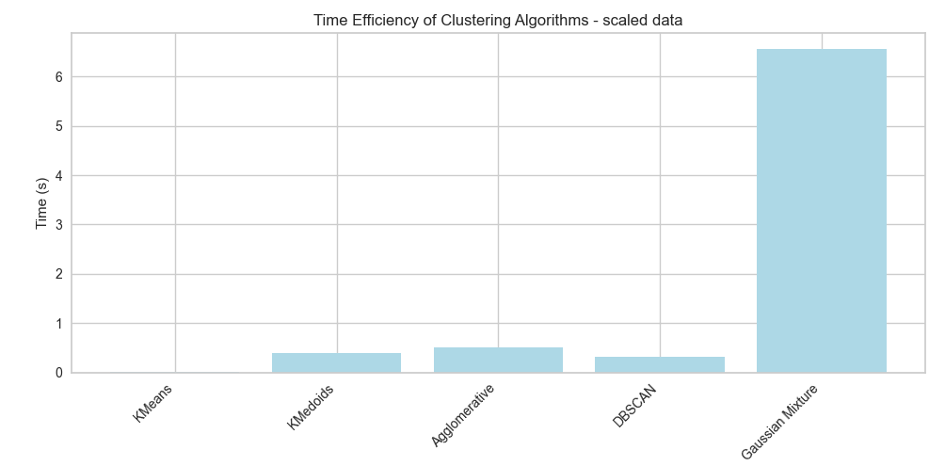
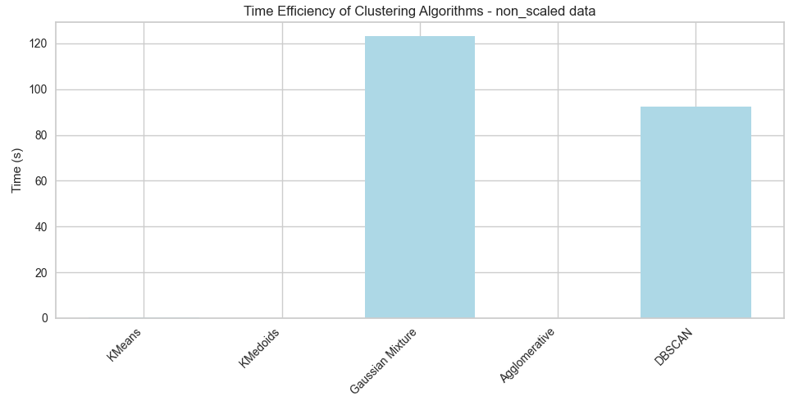
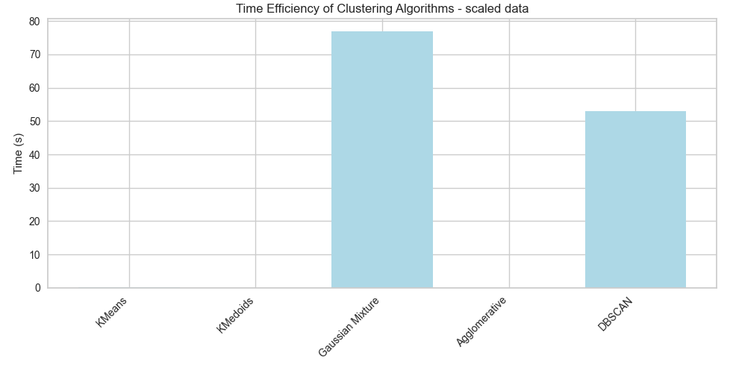
Reference: 04_Model_Selection.ipynb
Model Selection
Genre_data.csv
Data.csv
Best Algorithm: K-Means
DA 204o: Data Science in Practice
11

Slide 12
Hyperparameter Tuning
Reference: 05_hyperparameter_tuning.ipynb
Grid Search- Genre Data
Best Parameters
Test data Evaluation
Grid Search Data
Best Parameters
Test data Evaluation
Init: k-means++
Max_iter:300
N_clusters:13
N_init:20
Tol:0.001
Silhouette score:0.2846
Davies-Bouldin Index:0.9270
Calinski-Harabasz:313.9262
Init: k-means++
Max_iter:300
N_clusters:11
N_init:10
Tol:0.0001
Silhouette score:0.2917
Davies-Bouldin Index:0.9754
Calinski-Harabasz:21179.5098
t-SNE
Genre Data
Best Parameters
Test Data Evaluation
KL Divergence : 0.4223
PCA
Data
PCA__svd_solver:’auto’
PCA__tol:0.0001
PCA__whiten:True
Early_exaggeration:24
Learning_rate:200
Max_iter:2000
Perplexity:50
Best Parameters
PCA__n_components:2
Test Data Evaluation
Reconstruction error:459695.2128
DA 204o: Data Science in Practice
12

Slide 13
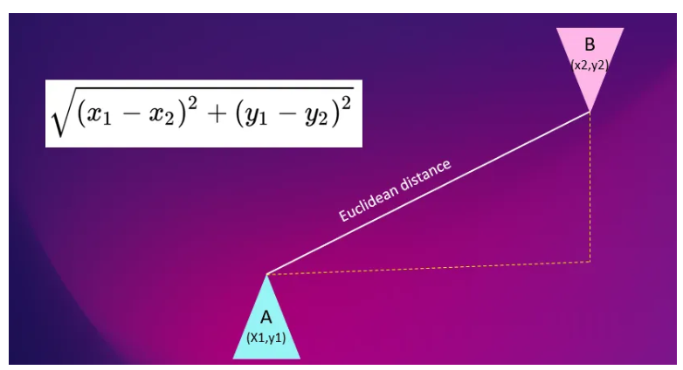
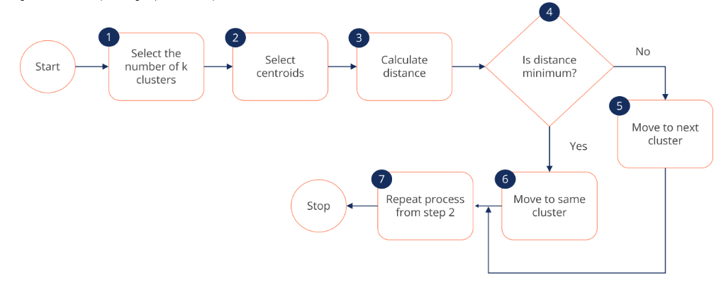
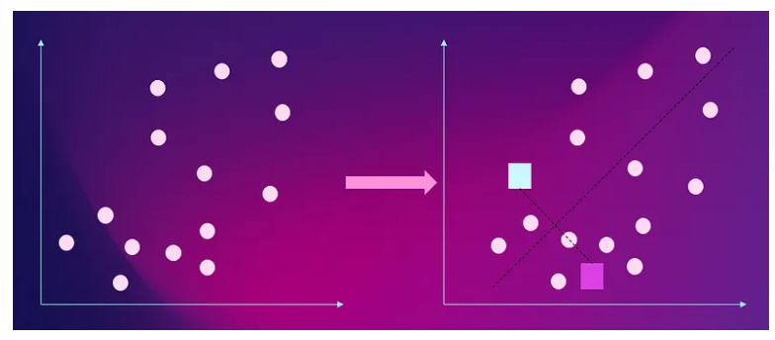
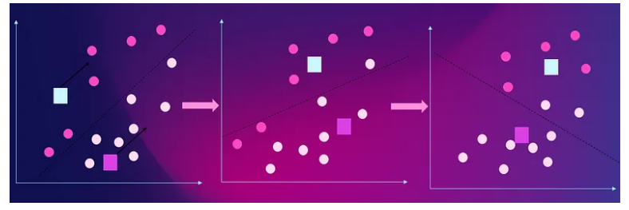
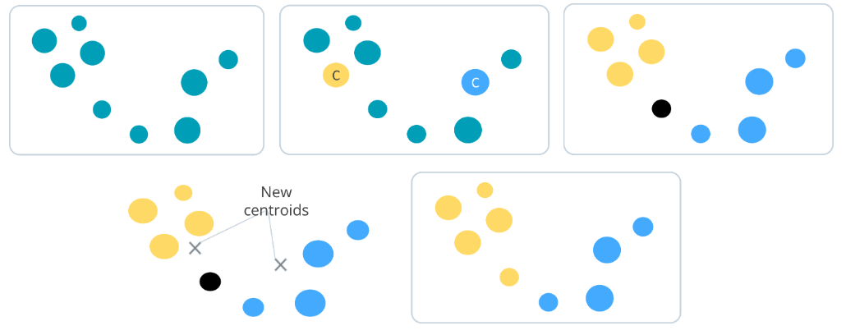
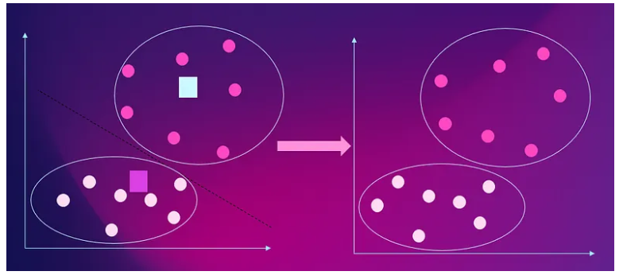
Model Training
Understanding K-Means….
Reference: 06_model_training.ipynb
Clustering is a fundamental technique in unsupervised machine learning, used to identify patterns within data by grouping similar data points together.
The core objective of a clustering algorithm is to locate data points that share common characteristics, thus assigning them to the same cluster.
Euclidean Distance
K-means in Action
Assignment & Optimization Step
Iteration

Slide 14
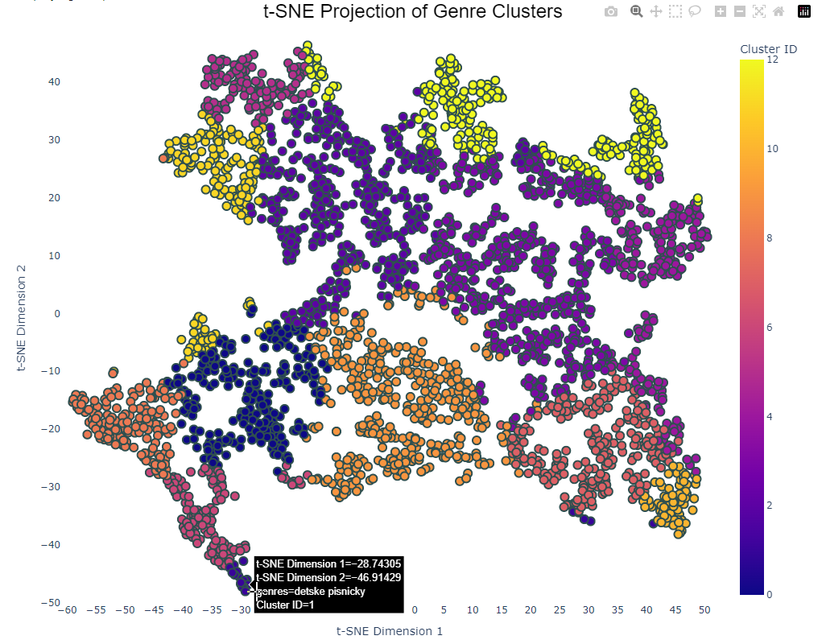
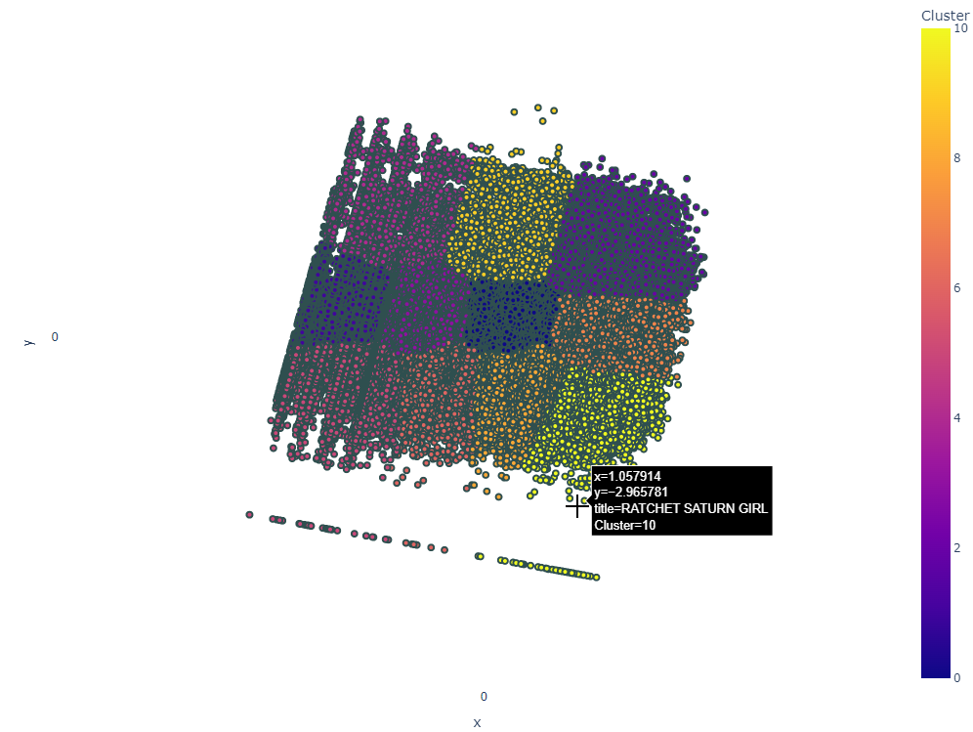
Model Training
Reference: 06_model_training.ipynb
t-SNE
Our analysis shows that songs from the same genre group together in our dataset.
This pattern is clear and expected, as songs within a genre typically share many features like beat, instruments, and even the era they're from.
This grouping is great for making music recommendations. If you like a particular song, chances are you'll enjoy other songs that are close to it in our dataset.
These songs aren't just similar in sound—they share a style and vibe that appeal to the same taste.
How We Use This for Better Recommendations:
We can use this information to suggest songs that you are likely to enjoy. By looking at the songs you've listened to and loved, our system finds other songs from the same cluster and recommends them to you.
It's like having a smart DJ who knows exactly what you like and what to play next.
This isn't about guessing what you might like; it's about using data to find perfect matches based on your previous choices.
The result? Every song suggestion feels personal and just right for your musical preferences.
PCA

Slide 15
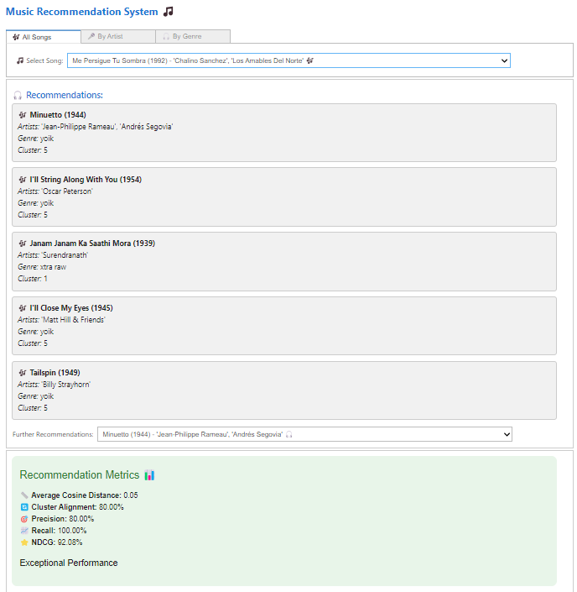
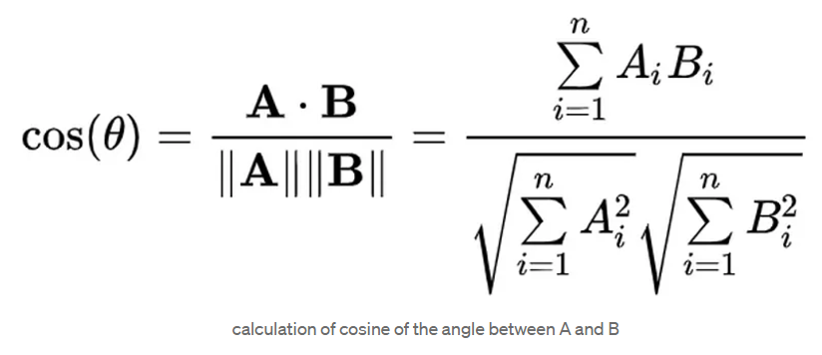
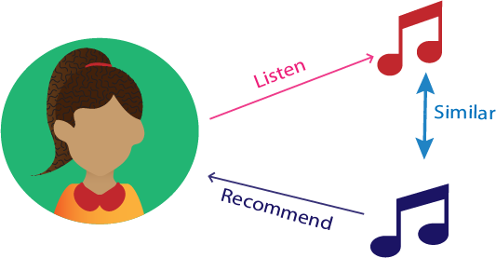
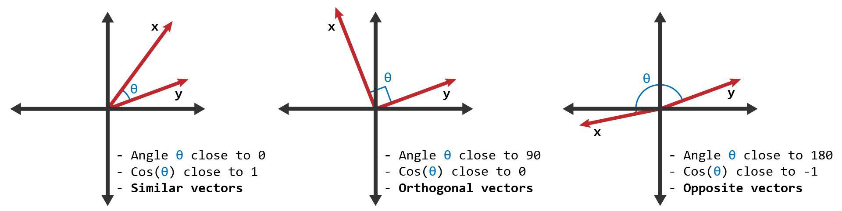
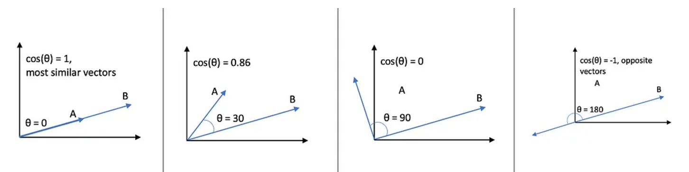
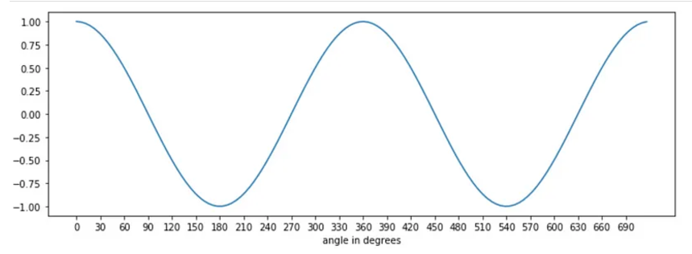
Model Deployment
Reference: 07_model_deployment.ipynb
Content-based filtering recommends items based on the features and attributes of the items themselves, often comparing the similarity between item profiles to determine which items to recommend to a user.
A cosine similarity is a value that is bound by a constrained range of 0 and 1. The closer the value is to 0 means that the two vectors are orthogonal or perpendicular to each other. When the value is closer to one, it means the angle is smaller and the songs are more similar.
Why cosine of the angle between A and B gives us the similarity?
If we look at the cosine function, it is 1 at theta = 0 and -1 at theta = 180, that means for two overlapping vectors cosine will be the highest and lowest for two exactly opposite vectors.
Average Cosine Distance: Measures the average cosine similarity between items in a dataset, with a value of 0 indicating perfect similarity.
Cluster Alignment: Indicates the percentage of data points that are correctly grouped into their respective clusters as per the model's predictions.
>> Precision: The proportion of positive identifications that were correct.
>> Recall: The proportion of actual positives that were correctly identified.
>> NDCG (Normalized Discounted Cumulative Gain): A measure of ranking quality, assessing the
effectiveness of a recommendation system by weighing the ranks of relevant items.

Slide 16
Current Capability
Data Handling: Utilizes features like valence and danceability, shuffled and sampled for processing efficiency.
Recommendation Mechanics: Employs cosine similarity to recommend songs based on nearest feature neighbors.
Interactive Interface: Uses IPython widgets for dynamic song, artist, and genre selection.
Performance Metrics: Measures effectiveness through precision, recall, and NDCG scores, displayed in real-time.
Recursive Recommendations: Allows users to explore deeper into song recommendations iteratively.
Future Scope
Algorithm Optimization: Explore deep learning for feature extraction and collaborative filtering for personalized recommendations.
Real-time Processing: Adapt system to handle live data updates and scale efficiently with larger datasets.
Personalization: Develop user profiles and contextual filters for mood-based recommendations.
Advanced Metrics: Implement A/B testing and use engagement metrics for continuous improvement.
User Experience: Enhance interface with audio previews and detailed visualizations of song features.

Slide 17
Roles & Responsibilities
Stage | Notebook | Description | Responsibilities
Check point 1 | 01_data_collection.ipynb | Notebook for the task of data collection, likely involving gathering data | Bagi Shirisha Review: Priyabrata Samantaray
 | 02_data_preprocessing.ipynb | Notebook focused on preprocessing the collected data, which includes cleaning, outlier’s detection, feature extraction, etc. | Gayatri Yendamury Review: Vineet Kumar Tripathi
 | 03_data_Exploration.ipynb | Notebook for exploring the data through statistical analysis and visualization to understand patterns etc. | Bagi Shirisha, Gayatri Yendamury Review: All
Check point 2 | 04_model_selection.ipynb | Notebook dedicated to selecting the appropriate model for the data. | Priyabrata Samantaray, Vineet Kumar Tripathi Review: Bagi Shirisha, Gayatri Yendamury
 | 05_hyperparameter_tuning.ipynb | Notebook for tuning the hyperparameters of the selected model to optimize performance. | Bagi Shirisha, Gayatri Yendamury Review: Priyabrata Samantaray, Vineet Kumar Tripathi
 | 06_model_training.ipynb | Notebook for training the model using the preprocessed and optimized data. | Priyabrata Samantaray, Vineet Kumar Tripathi Review: All
 | 07_model_deployment.ipynb | Notebook for deploying the trained model into a production environment or for further validation. | Priyabrata Samantaray, Vineet Kumar Tripathi Review: All

Slide 18
Data Science Canvas |  |  | Project: | Personalized Music Recommendation System
 |  |  | Team: | 1. Gayatri Yendamury 2. Bagi Shirisha 3. Priyabrata Samantaray 4. Vineet Kumar Tripathi
Problem Statement |  |  |  | Execution & Evaluation |  | Data Collection & Preparation
Business Case & Value Added Which business case should be analyzed and what added value does it generate? Enhances user experience by providing personalized, relevant music recommendations, which drive user engagement and retention, offering a competitive edge in the music streaming market. | Model Selection Which analysis methods can be considered on the basis of the specific data landscape and the business case? Using K-Means clustering and content-based filtering. | Model Requirements Which model requirements must be complied with in order to obtain a valid model? The system must handle scalable feature engineering and must deliver recommendations without significant lag, ensuring data used in the model is current and relevant. | Skills What skills are needed to provide the data and model development? Proficiency in Python, data manipulation with Pandas, visualization with Matplotlib and Seaborn, machine learning with Scikit-learn, and a good understanding of recommendation algorithms. | Model Evaluation Which indicators require quality control and validation and how should they be interpreted? Is real-time monitoring necessary? Success metrics will include precision, recall, and relevance of the recommendations. Continuous performance monitoring is recommended to adjust models in real-time based on user feedback and interaction. | Data Storytelling What requirements does the target group have for the presentation of the results and how do I effectively communicate this data? Results will be presented using clear, actionable charts and summaries. Emphasis on key findings and how the model improves user experience and engagement. | Data Selection & Cleansing Which of the available data is relevant? Do the data have to be cleaned up? Data is relevant to the current trends and user needs. Regular updates and cleaning of data sets are crucial to maintain the effectiveness of the recommendations. | Data Collection How and with which methods should additionally required data be collected? What properties has this data to fulfil? Collection of song metadata, user behavior data, and preferences. Focus on cleaning the data for accuracy by addressing missing values, duplicates, and inconsistencies.
 |  |  |  |  |  | Data Integration In which system should the data from different sources be migrated? Data from various sources (song metadata, user data, and interaction data) should be integrated into a unified database for efficient processing and analysis. | Explorative Data Analysis Are there outliers or structures to be considered? Creation of descriptive key figures for the first assessment of the data. Identify outliers, perform summary statistics, and visualize data distributions to understand underlying patterns. Use these insights for feature engineering and model refinement.
Data Landscape Which data is required for this, and which is already available? Which additional data must be collected? Required song attribute data is already available in the Spotify dataset. Additional user interaction data is optional for enhancing recommendations. |  | Software & Libraries Which software should be used? Is there already a standard solution? Which libraries are used? Python is the primary software, using libraries like Pandas, NumPy, Scikit-learn, Matplotlib, and Seaborn for data analysis and model building. No standard solution is required beyond these tools. |  |  |  | Data Integration In which system should the data from different sources be migrated? Data from various sources (song metadata, user data, and interaction data) should be integrated into a unified database for efficient processing and analysis. | Explorative Data Analysis Are there outliers or structures to be considered? Creation of descriptive key figures for the first assessment of the data. Identify outliers, perform summary statistics, and visualize data distributions to understand underlying patterns. Use these insights for feature engineering and model refinement.
Adopted from: https://github.com/tomalytics/datasciencecanvas

